Slide 1
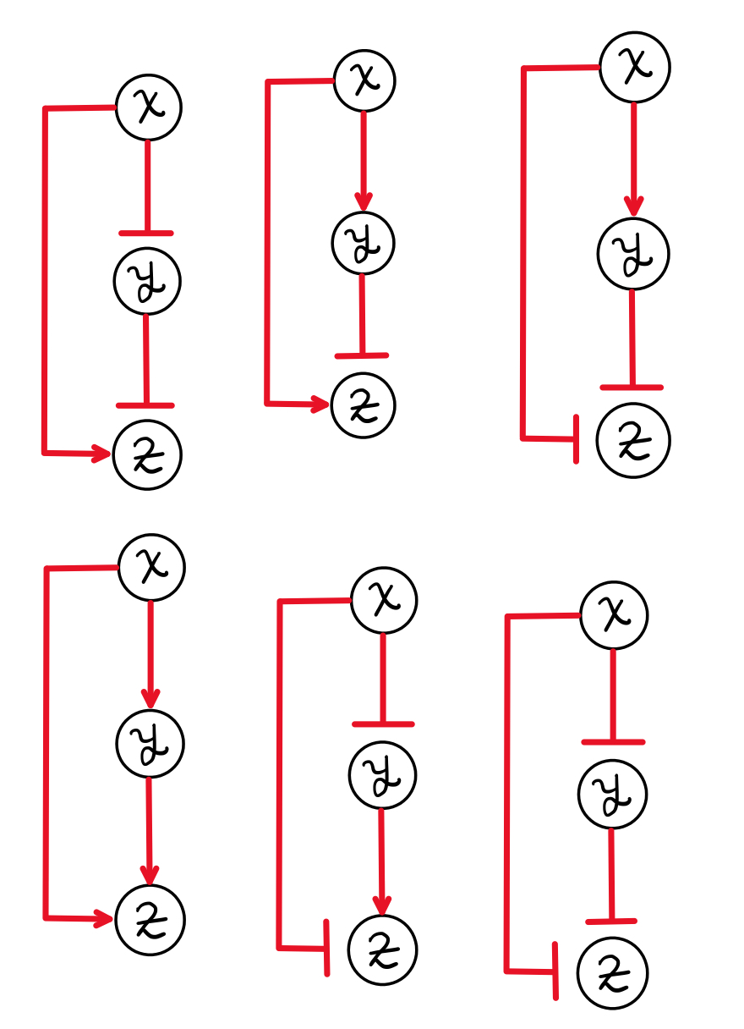
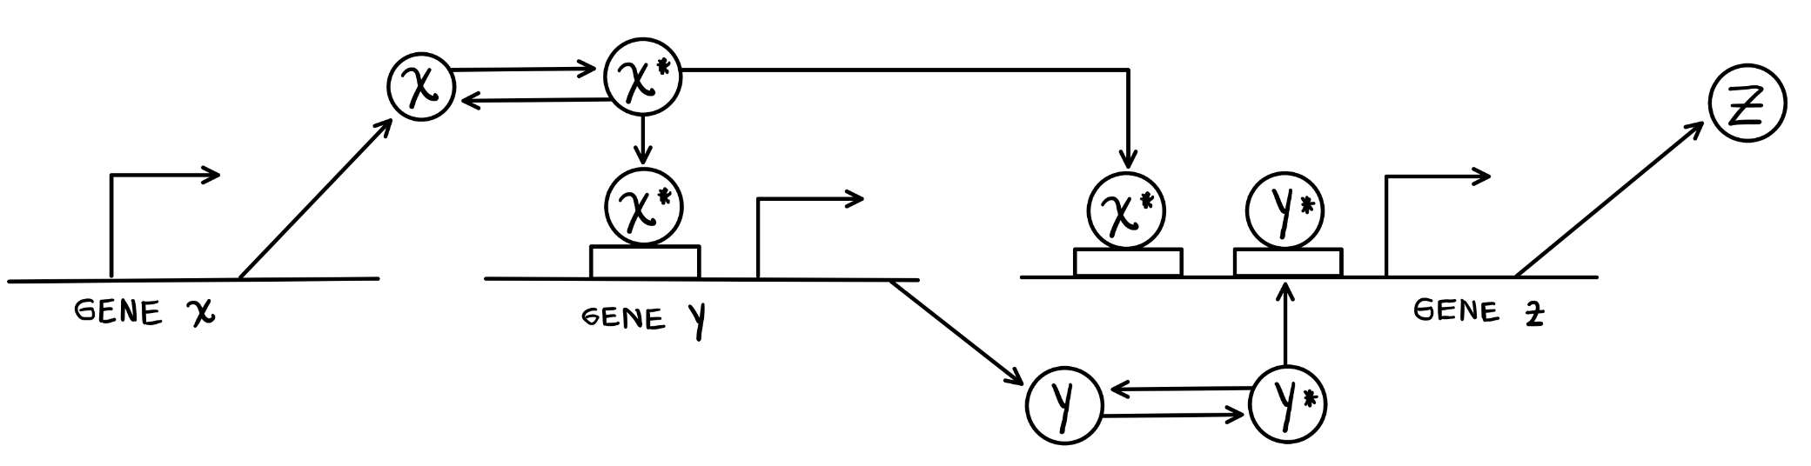

Health, mortality and Human Aging
Rafael Enrique Velásquez Rojas

Slide 2
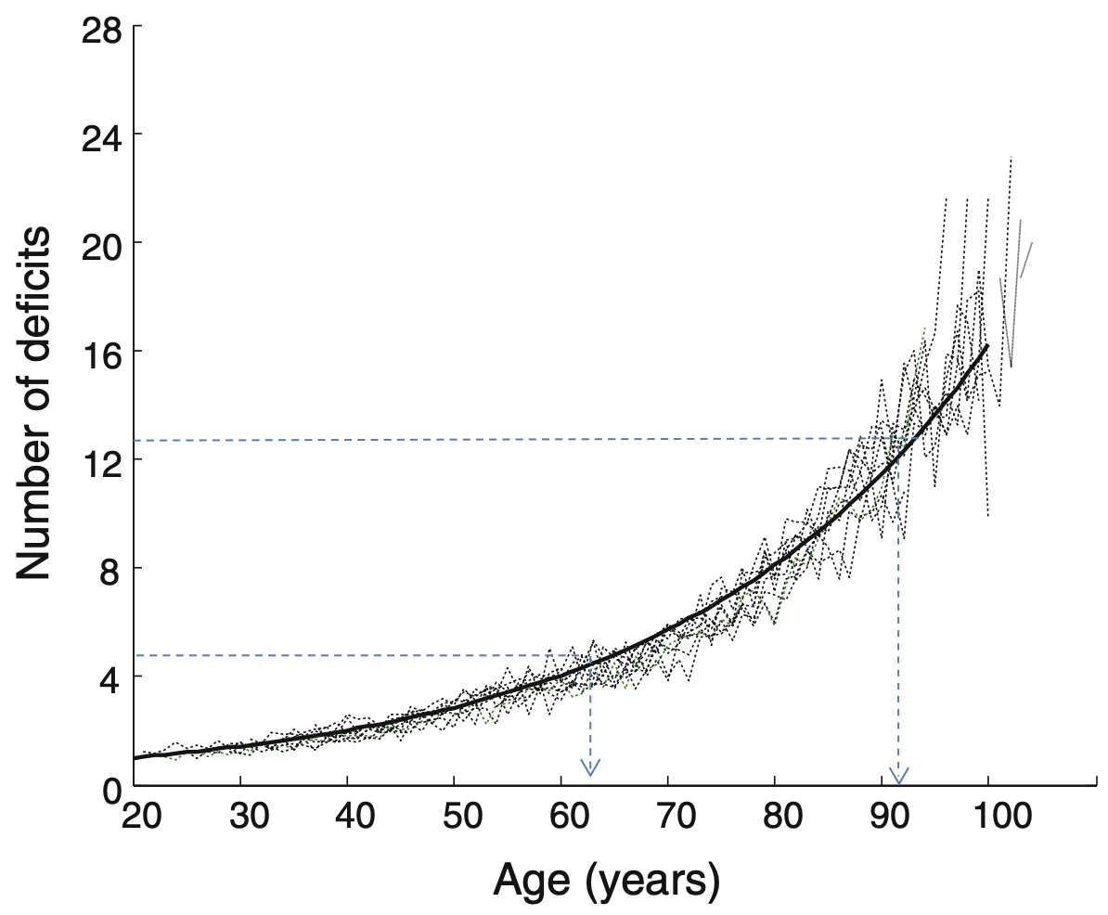
Health worsens with age
Highly heterogeneous
Image from: Mitnitski, A., Song, X., & Rockwood, K. (2013). Assessing biological aging: the origin of deficit accumulation. Biogerontology, 14, 709-717.
Slide 1

Slide 3
Health worsens with age
Highly heterogeneous
Accumulation of deficits with the age
Image from: Mitnitski, A., Song, X., & Rockwood, K. (2013). Assessing biological aging: the origin of deficit accumulation. Biogerontology, 14, 709-717.
Slide 1

Slide 4
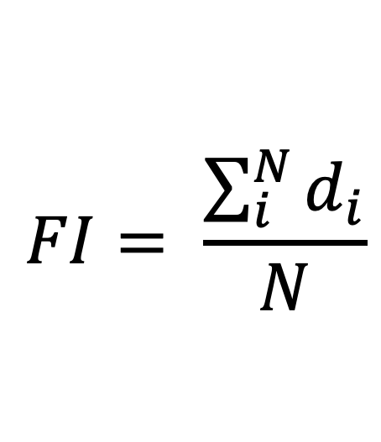
Health worsens with age
Highly heterogeneous
Accumulation of deficits with the age
$$FI= \frac{\sum_{i}^{N}{d_{i}}}{N}$$
Frailty Index as a measure of deficit accumulation
Image from: Mitnitski, A., Song, X., & Rockwood, K. (2013). Assessing biological aging: the origin of deficit accumulation. Biogerontology, 14, 709-717.
Slide 1

Slide 5
Mortality Increase with the Age
Phenomenological behaviour of mortality
Slide 2

Slide 6
Mortality Increase with the Age
Phenomenological behaviour of mortality
Atypical behaviour in the 20s
Slide 2

Slide 7
Mortality Increase with the Age
Phenomenological behaviour of mortality
Atypical behaviour in the 20s
After 40 age = Exponential increment
Slide 2

Slide 8
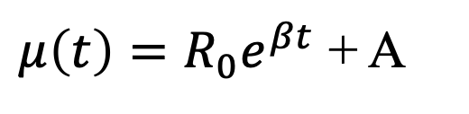
Gompertz Law to model the exponential increment
$μ\left(t\right)=R_{0}e^{βt}$ + A
Exponential model to explain the exponential increment of mortality with age
Sum of age dependent term and age independent term
Slide 3
Notes:
Some population there are described by high age independent death rates

Slide 9
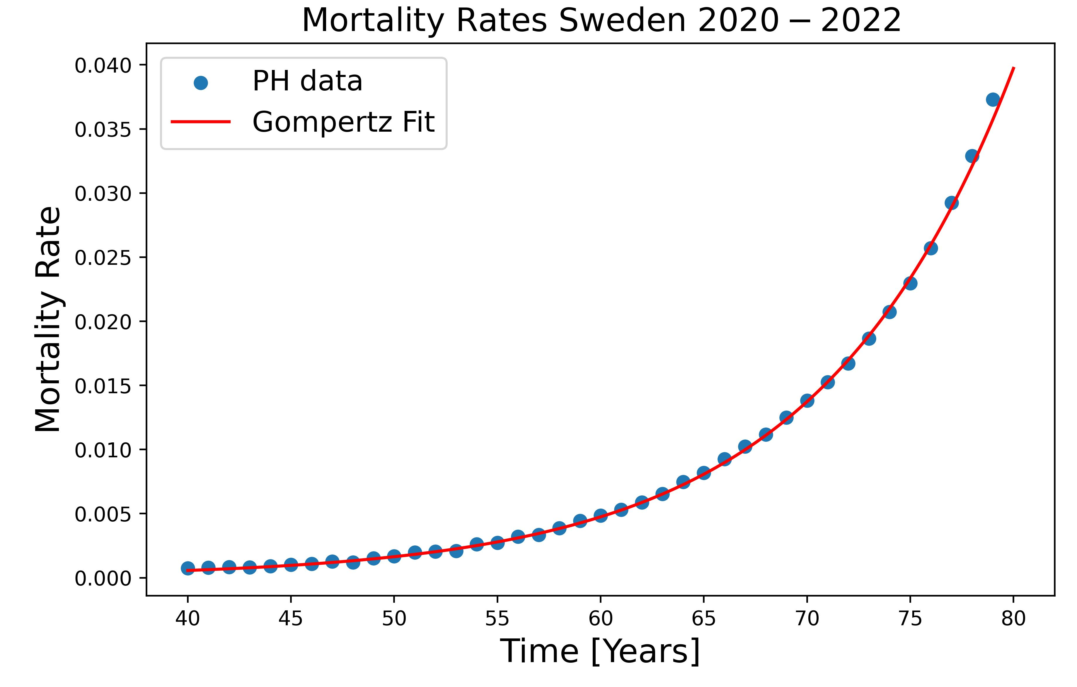
Gompertz Law to model the exponential increment
$μ\left(t\right)=R_{0}e^{βt}$ + A
Exponential model to explain the exponential increment of mortality with age
Sum of age dependent term and age independent term
Slide 3
Notes:
Some population there are described by high age independent death rates

Slide 10
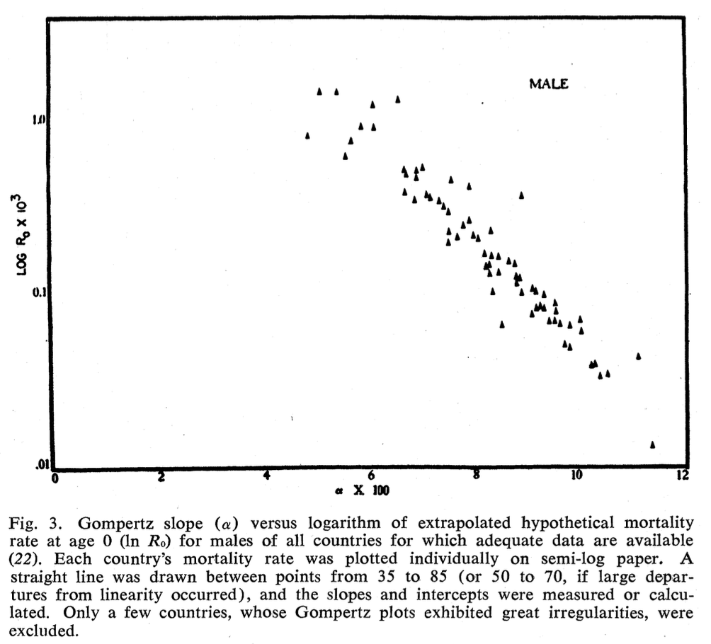
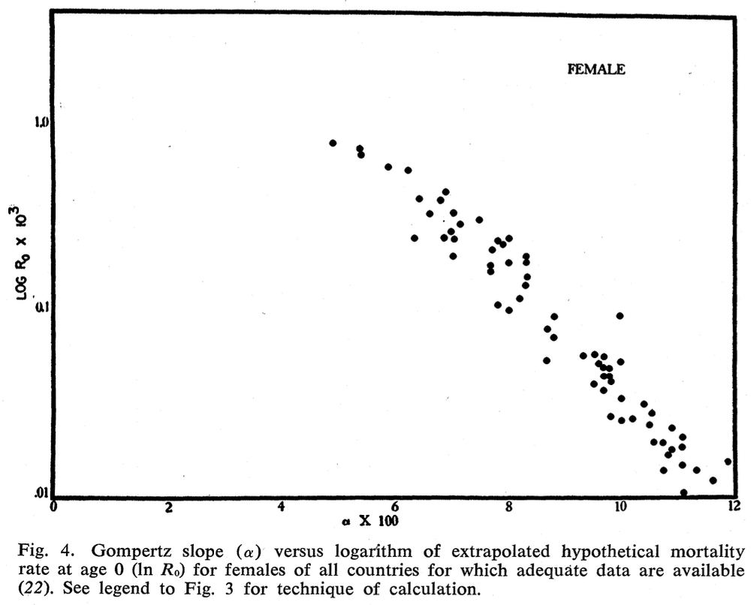
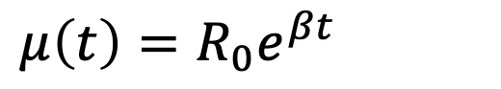
Strehler-Mildvan Correlation
$μ\left(t\right)=R_{0}e^{βt}$
Gompertz Law exponential mortality
Slide 4
Notes:
Some population there are described by high age independent death rates

Slide 11
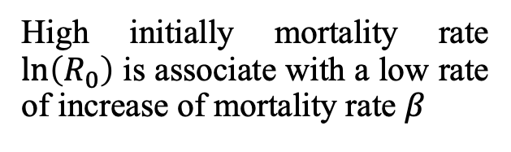
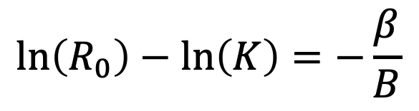
Strehler-Mildvan Correlation
$μ\left(t\right)=R_{0}e^{βt}$
Gompertz Law exponential mortality
$$\ln\left(R_{0}\right)−\ln\left(K\right)=−\frac{β}{B}$$
Correlation between two parameters of Gompertz Law
High initially mortality rate $\ln\left(R_{0}\right)$ is associate with a low rate of increase of mortality rate $β$
Slide 4
Notes:
Some population there are described by high age independent death rates

Slide 12
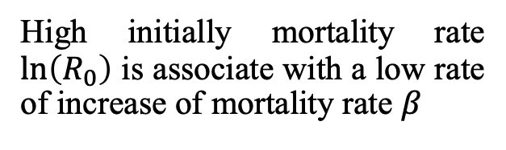
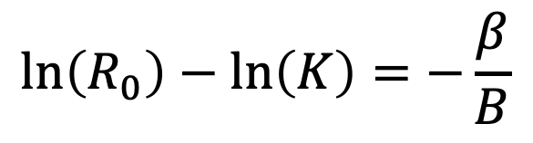
Strehler-Mildvan Correlation
$$\ln\left(R_{0}\right)−\ln\left(K\right)=−\frac{β}{B}$$
High initially mortality rate $\ln\left(R_{0}\right)$ is associate with a low rate of increase of mortality rate $β$
Slide 4
Notes:
Some population there are described by high age independent death rates

Slide 13

Human Mortality Database
Data resource on mortality in +40 developed countries
Data of:
Deaths
Population Size
Death Rates
Exposure to risk
Slide 7
Notes:
Some population there are described by high age independent death rates

Slide 14
Human Mortality Database
Slide 7
Notes:
Some population there are described by high age independent death rates

Slide 15
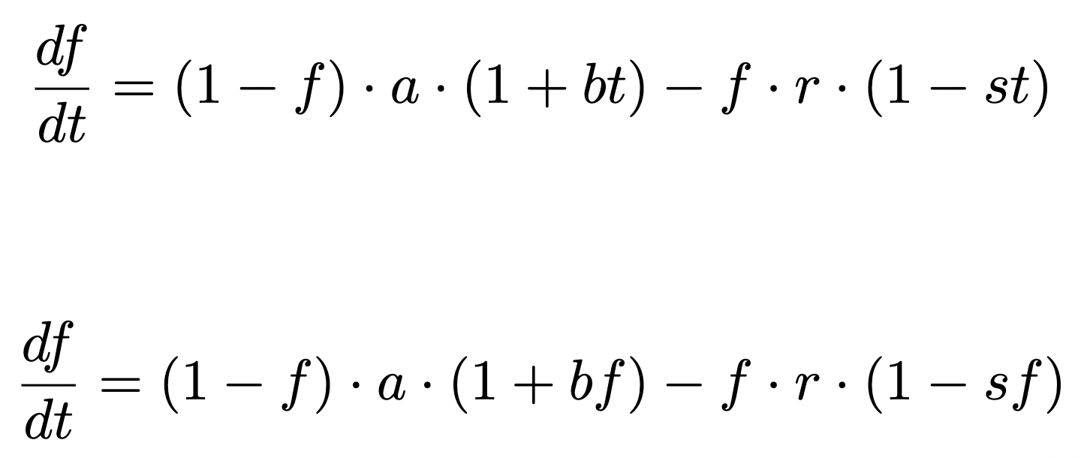
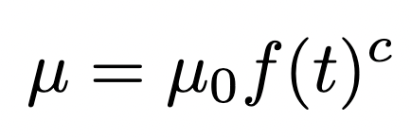
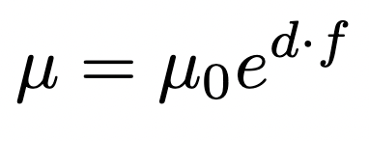
Developing a model for frailty index and mortality
Slide 8
Notes:
Some population there are described by high age independent death rates

Slide 16
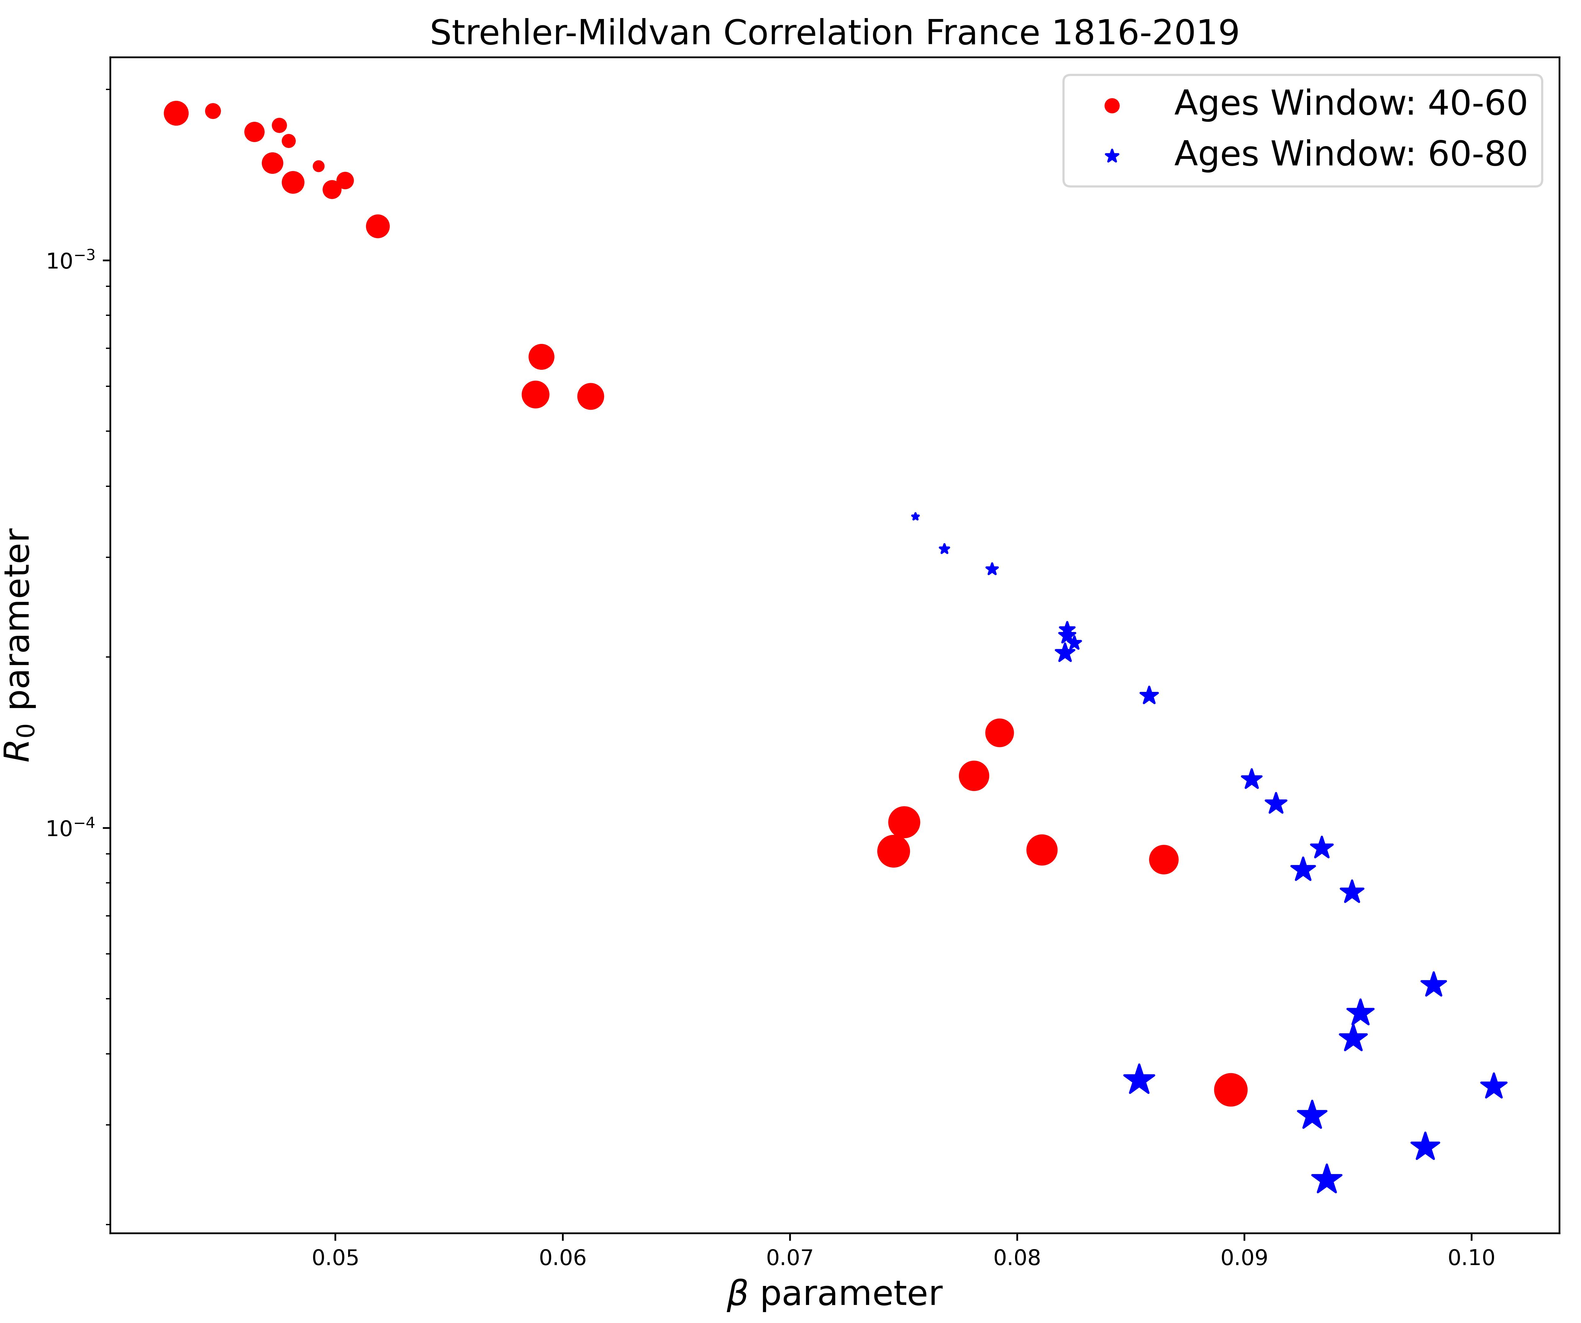
Strehler-Mildvan Correlation phenomenological data
Slide 9

Slide 17
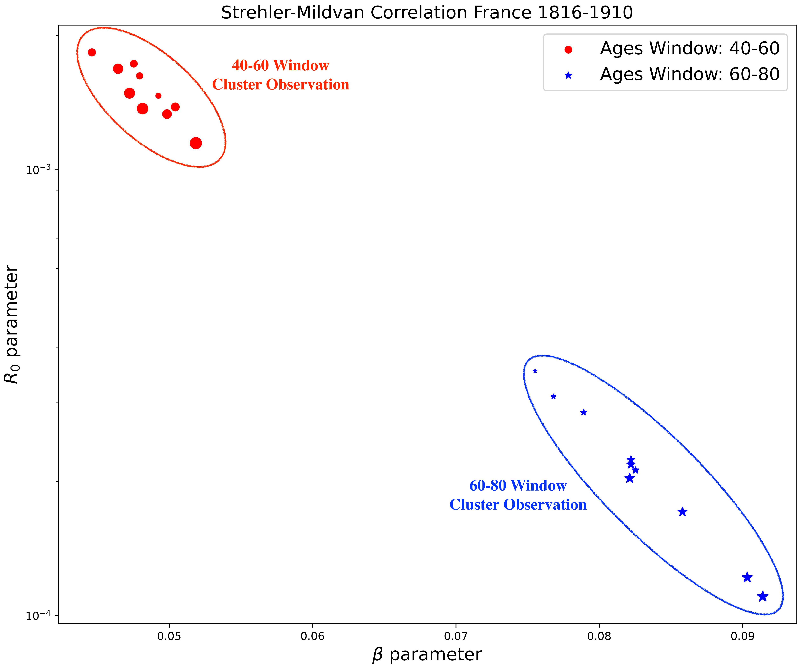
Strehler-Mildvan Correlation phenomenological data
Slide 9

Slide 18
Strehler-Mildvan Correlation phenomenological data
Slide 10

Slide 19
Strehler-Mildvan Correlation phenomenological data
Slide 10

Slide 20
Strehler-Mildvan Correlation phenomenological data
Differences in the correlation between the 40-60 window and the 60-80 window ages.
Slide 10

Slide 21
Strehler-Mildvan Correlation phenomenological data
Differences in the correlation between the 40-60 window and the 60-80 window ages.
Depending on the observation window, there are different values for the parameters of Gompertz’s Law.
Slide 10

Slide 22
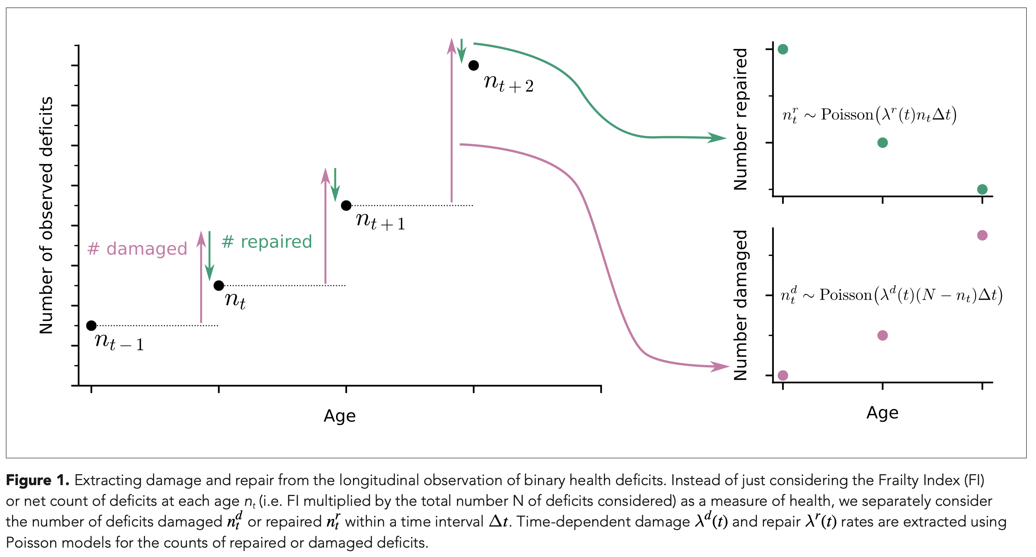
Number of Repaired and Damage Nodes
Slide XXX

Slide 23
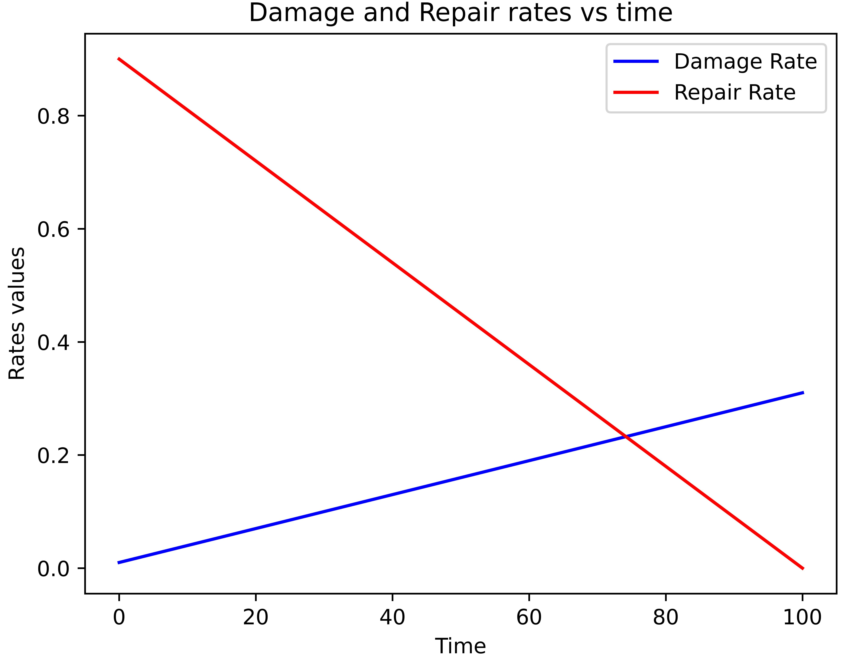
Number of Repaired and Damage Nodes
This is the behaviors of the damages and repair rates that we need to get the patterns that we want.
Slide XXX

Slide 24
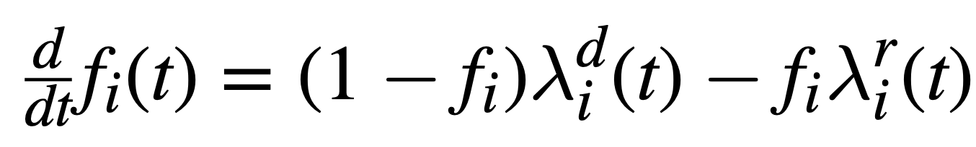
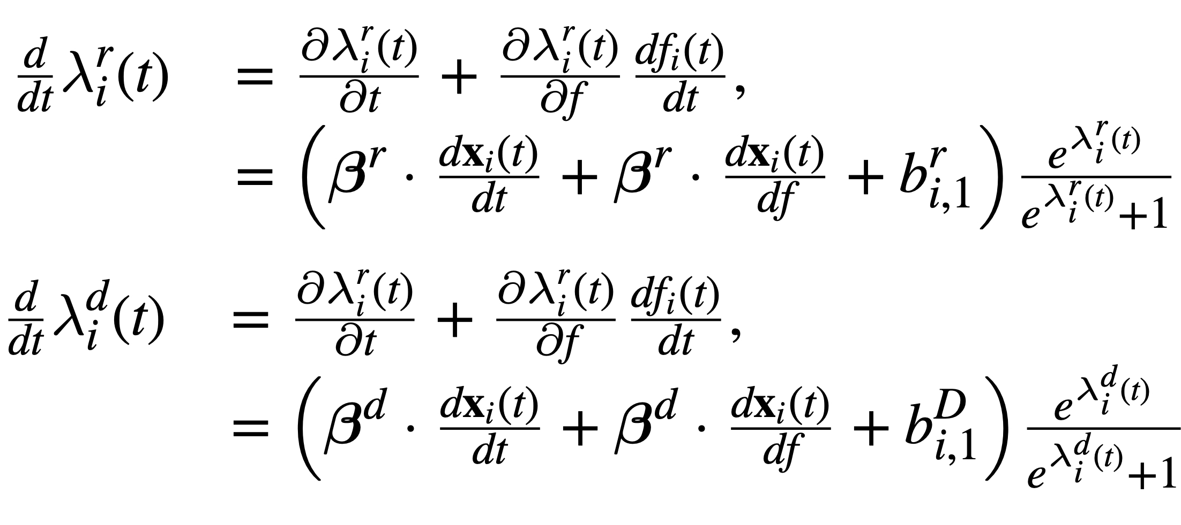
Repair and damages nodes model
Slide XXX

Slide 25




Developing a model for frailty index and mortality
Slide 8
Notes:
Some population there are described by high age independent death rates

Slide 26
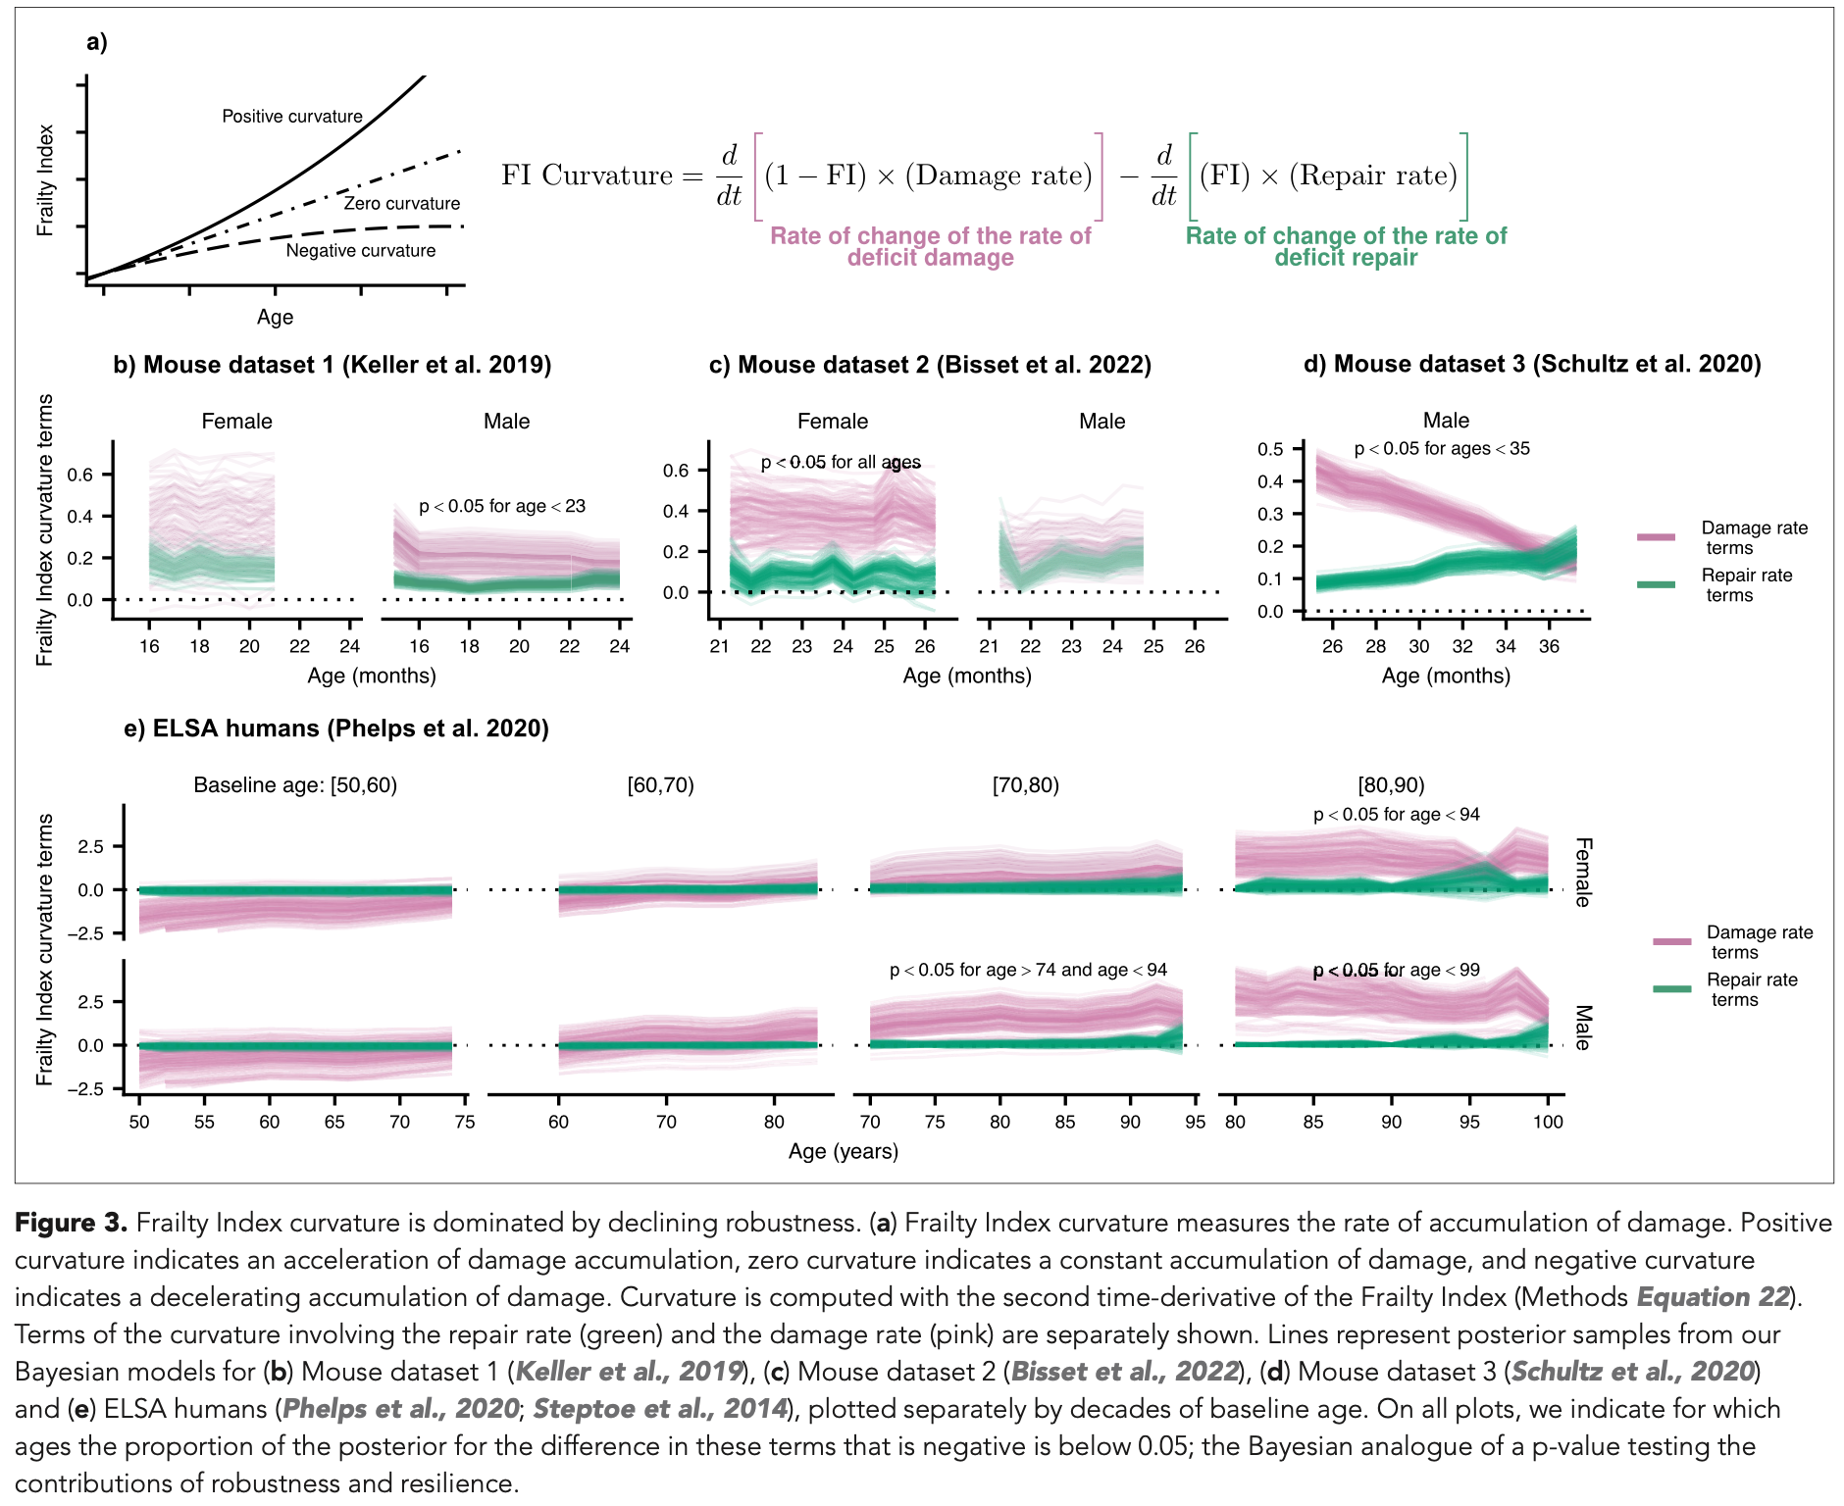
Frailty Index Curvature
Depending on the observation window, there are different values for the parameters of Gompertz’s Law.
Slide XXX

Slide 27
SM correlation is not a strong result
Here we will put results from phenomenological data that shows that Strehler-Mildvan Correlation is not a strong results.
The reason why we cant see the SM correlation as in the paper of 1960 is because:
Gompertz Slope (alpha) could change in the time
Ro could change in the time
Therefore, the correlation between this two values could be dynamic in time and not just one point for the entire curve of mortality rate.
Slide XXX

Slide 28
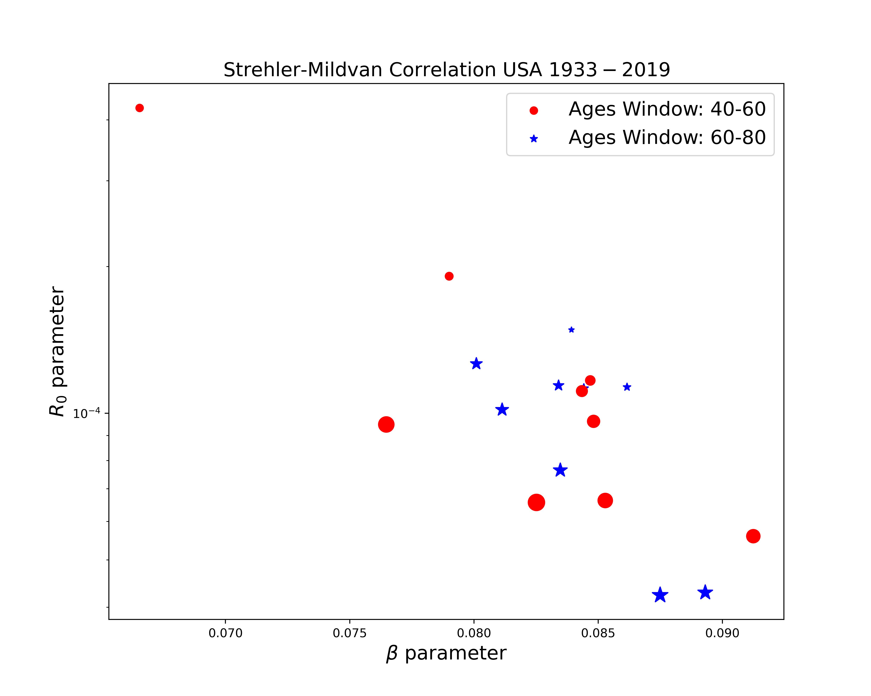

SM correlation is not a strong result

Slide 29
SM correlation is not a strong result

Slide 30
SM correlation is not a strong result

Slide 31
SM correlation is not a strong result
The reason why we cant see the SM correlation as in the paper of 1960 is because:
Gompertz Slope (alpha) could change in the time
Ro could change in the time
Therefore, the correlation between this two values could be dynamic in time and not just one point for the entire curve of mortality rate.
Here we will put results from phenomenological data that shows that Strehler-Mildvan Correlation is not a strong results.
Slide XXX

Slide 32
Model results for SM correlation
Slide XXX

Slide 33
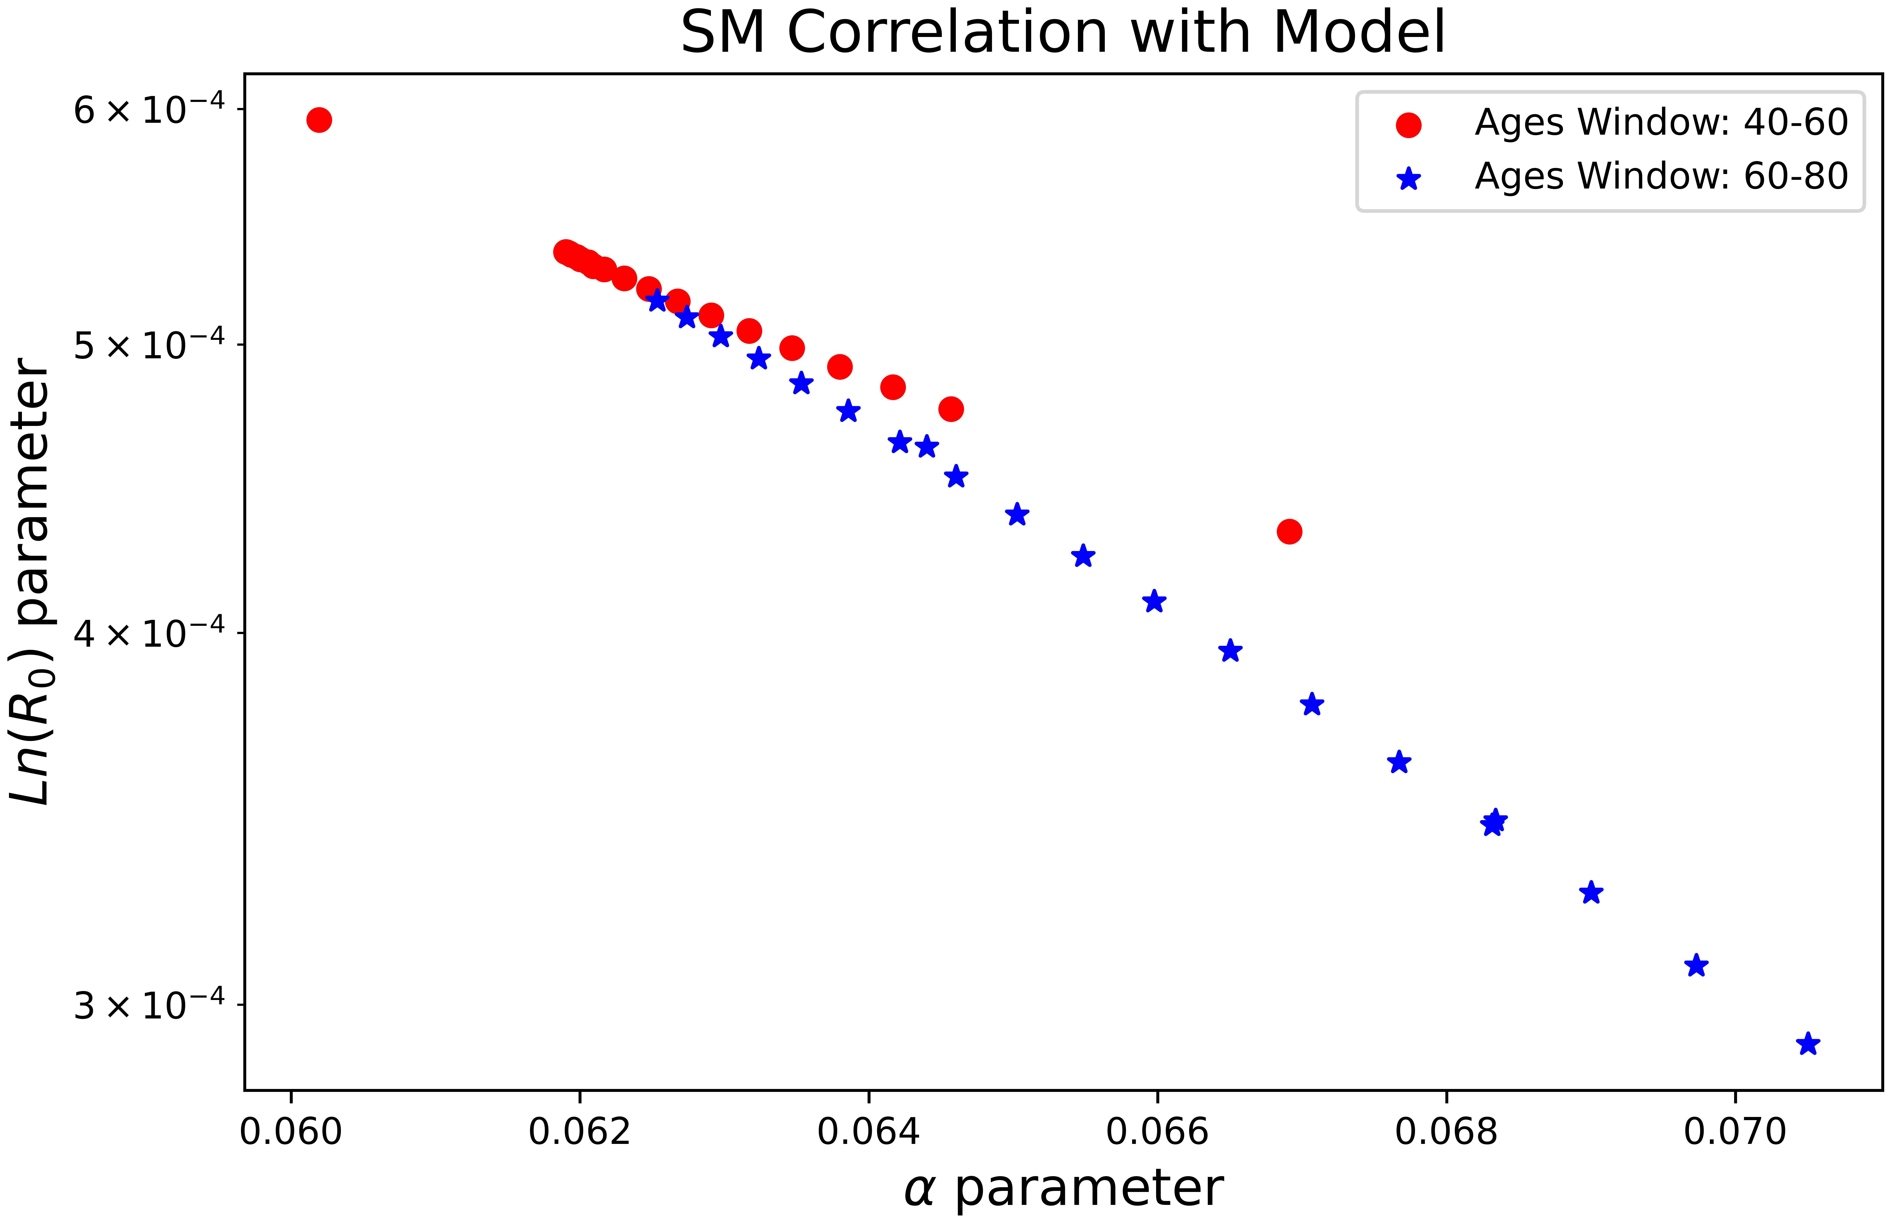
Model results for SM correlation
Slide XXX

Slide 34
Model results for SM correlation
Slide XXX

Slide 35
Model results for SM correlation
Slide XXX

